Slide 1
Enhanced E-R Models and Business Rules
Slides # 3
Prof Yousef B. mahdy

Slide 2
Enhanced E-R Models and Business Rules
Supertypes and Subtypes
Generalization and Specialization
Constraints in Supertype/Subtype Relationships
Supertype/Subtype Hierarchies
Entity Clusters
Business Rules: Introduction
Business Rules: Defining Structural Constraints
Business Rules: Defining Operational Constraints

Slide 3
Superclasses/Subclasses and Attribute Inheritance
An entity type (set) may have additional sub-groups that are meaningful and need be represented explicitly because of their significance to the database application
Example:
  Superclass: Employee
  Subclass: Administrative Officers, Lecturers, Technicians, Clerical Officers, Cleaners
Superclass/subclass relationship called an IS-A relationship
  E.g., Lecturer IS-A Employee
  Notation used is subset symbol ⊂ on connecting line from superclass to subclass
  “d” within circle indicates ‘disjoint’
  double line between superclass and circle indicates TOTAL participation
An entity in a subclass inherits all attributes of its superclass

Slide 4
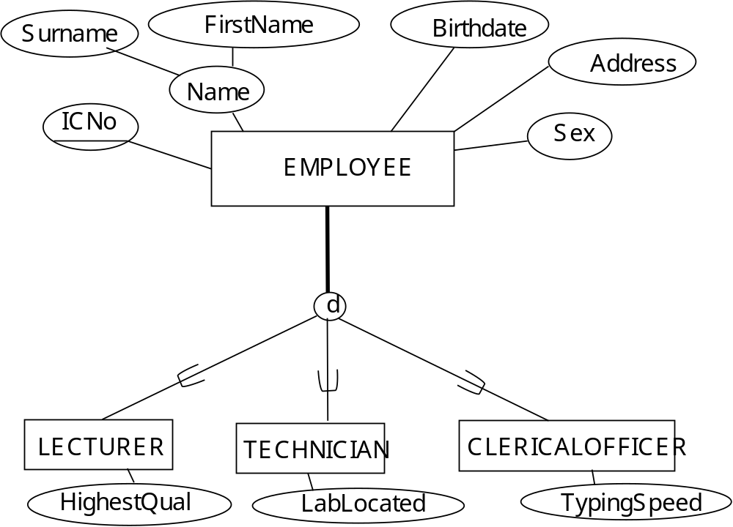

Slide 5
Supertypes and Subtypes
Subtype vs Supertype – (Figure 1)
  Subtype is a subgrouping of the entities in an entity type which has attributes that are distinct from those in other subgroupings. Examples: CAR, TRUCK
  Supertype is a generalized entity type that has a relationship with one or more subtypes. Example: VEHICLE
Attribute Inheritance (Figure 2)
  subtype entities inherit values of all attributes of the supertype
  An instance of a subtype is also an instance of the supertype
Use of Subtypes and Subtypes
  unique attributes among subtypes
  The instances of a subtype may participate in a relationship unique to that subtype Figures 3

Slide 6
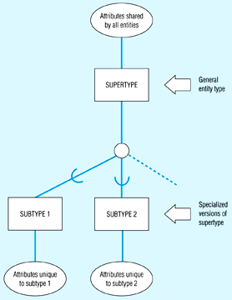
Figure 1: Basic rotation for supertype/subtype relationships

Slide 7
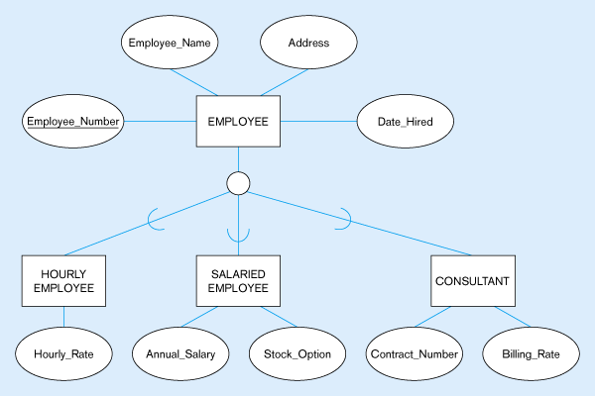
Figure 2 -- Employee supertype with three subtypes
All employee subtypes will have emp nbr, name, address, and date-hired
Each employee subtype will also have its own attributes

Slide 8
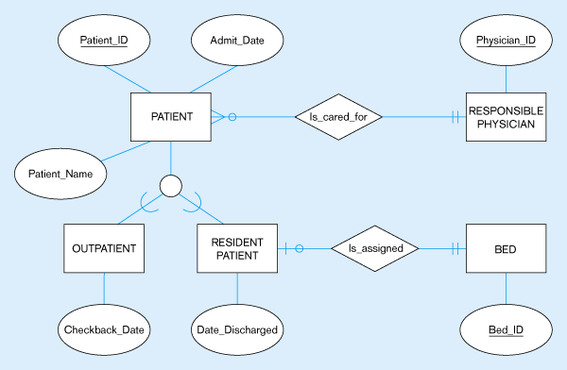
Figure 3 -- Supertype/subtype relationships in a hospital
Both outpatients and resident patients are cared for by a responsible physician
Only resident patients are assigned to a bed

Slide 9
Generalization and Specialization
Generalization
  the process of defining a more general entity type from a set of more specialized entity types Bottom-Up
  from three specialized entity types (CAR, TRUCK, MOTORCYCLE) in Figure 4a to a general entity type (VEHICLE) in Figure 4b
Specialization
  the process of defining one or more subtypes of the supertype, and forming supertype/subtype relationships Top-Down
  Figure 5a to Figure 5b

Slide 10
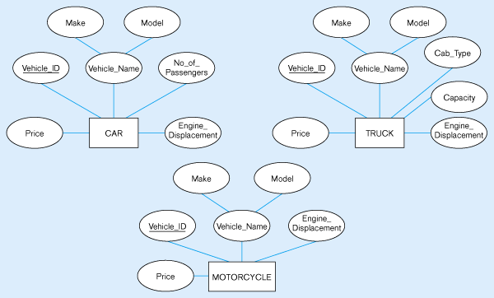
Figure 4 – Example of generalization
(a) Three entity types: CAR, TRUCK, and MOTORCYCLE
All these types of vehicles have common attributes

Slide 11
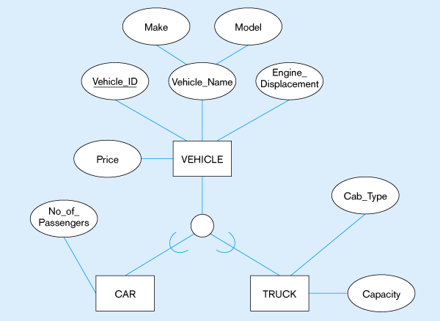
Figure 4(b) – Generalization to VEHICLE supertype
So we put the shared attributes in a supertype
Note: no subtype for motorcycle, since it has no unique attributes

Slide 12
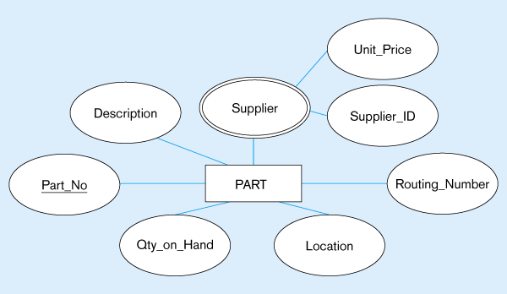
Figure 5 – Example of specialization
(a) Entity type PART
Applies only to purchased parts
Only applies to manufactured parts

Slide 13
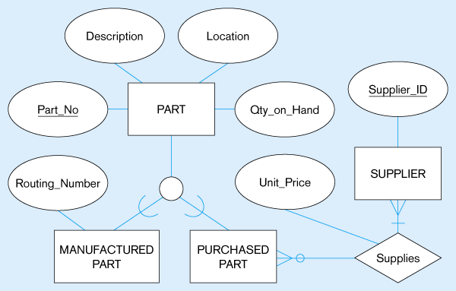
Figure 5(b) –
Specialization to MANUFACTURED PART and PURCHASED PART
Created 2 subtypes
Note: multivalued attribute was replaced by a relationship to another entity

Slide 14
Constraints in Supertype/Subtype Relationships
Completeness Constraints: Whether an instance of a supertype must also be a member of at least one subtype.
  Total Specialization Rule: Yes (Figure 6a; note the double line convention)
  Partial Specialization Rule: No (Figure 6b; single line)
Disjointness Constraints: Whether an instance of a supertype may simultaneously be a member of two (or more) subtypes.
  Disjoint Rule: No (Figure 7a)
  Overlap Rule: Yes (Figure 7b)
Subtype Discriminators: An attribute of the supertype whose values determine the target subtype(s).
  Disjoint (Figure 8): a simple attribute
  Overlapping (Figure 9): a composite attribute

Slide 15
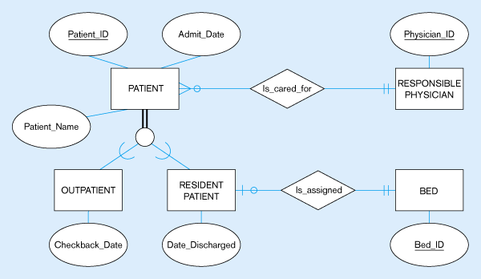
Figure 6a: Completeness Constraints - Total Specialization Rule
A patient must be either an outpatient or a resident patient

Slide 16
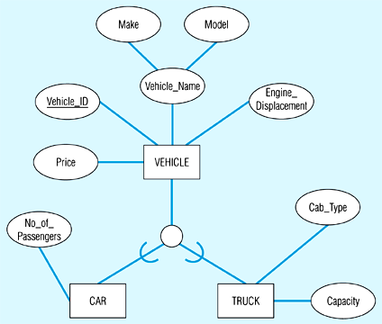
Figure 6b: Completeness Constraints - Partial Specialization Rule
A vehicle could be a car, a truck, or neither

Slide 17
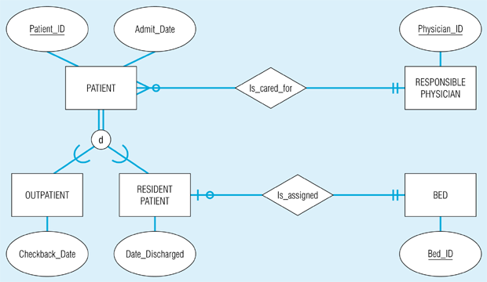
Figure 7a: Disjointness Constraints - Disjoint rule
A patient can either be outpatient or resident, but not both

Slide 18
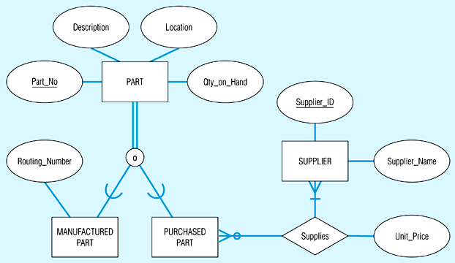
Figure 7b: Disjointness Constraints - Overlap Rule
A part may be both purchased and manufactured

Slide 19
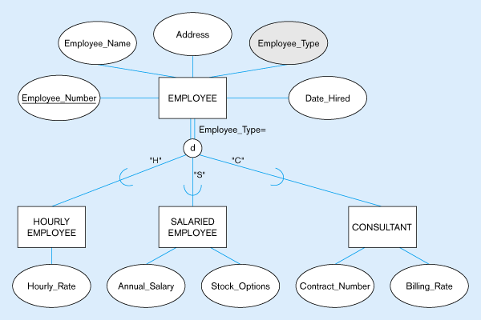
Figure 8 – Introducing a subtype discriminator (disjoint rule)
A simple attribute with different possible values indicating the subtype

Slide 20
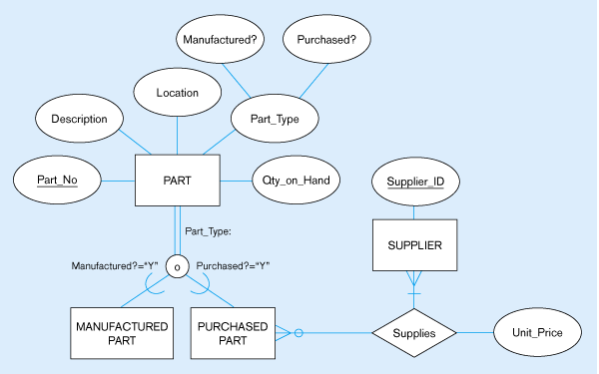
Figure 9 – Subtype discriminator (overlap rule)
A composite attribute with sub-attributes indicating “yes” or “no” to determine whether it is of each subtype

Slide 21
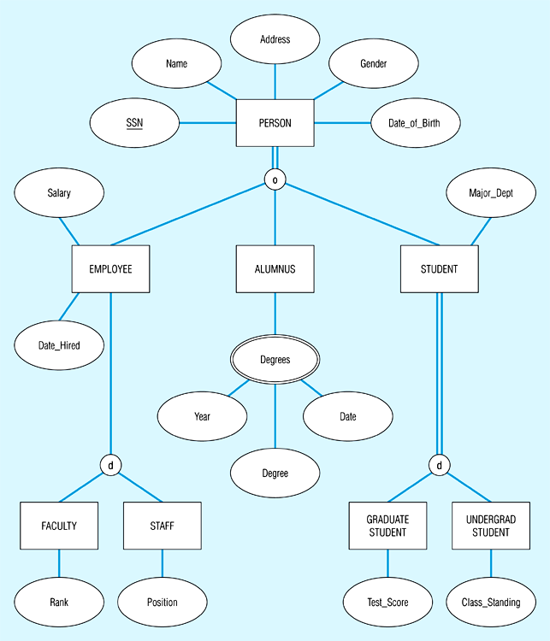
Figure 10: Example of supertype/subtype hierarchy

Slide 22
Entity Clusters
EER diagrams are difficult to read when there are too many entities and relationships
Solution: group entities and relationships into entity clusters
Entity cluster: set of one or more entity types and associated relationships grouped into a single abstract entity type
Examples:
  Pine Valley Furniture (Figure 13a)
  Entity Clusters (Figure 13b)

Slide 23
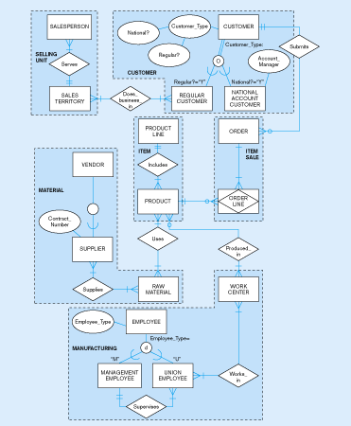
Figure 13(a)
Pine Valley Furniture
Related groups of entities could become clusters

Slide 24
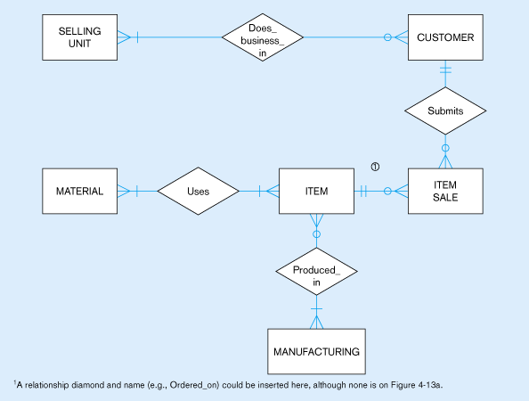
Figure 13(b) – EER diagram of PVF entity clusters
More readable, isn’t it?

Slide 25
BUSINESS RULES: An introduction
Business Rule
  A statement that defines or constratints some aspect of the business
  To assert business structure or to control or influence the behavior of the business
Classification of Business Rules (Figure 11)
  Derivation – rule derived from other knowledge
  Structural assertion – rule expressing static structure
  Action assertion – rule expressing constraints/control of organizational actions; an example

Slide 26
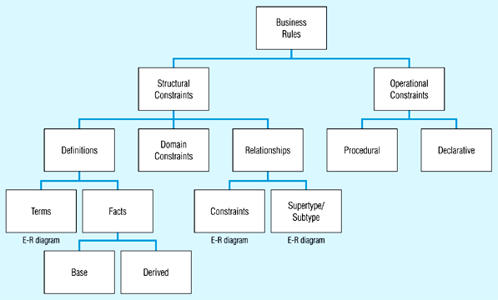
Classification of business rules

Slide 27
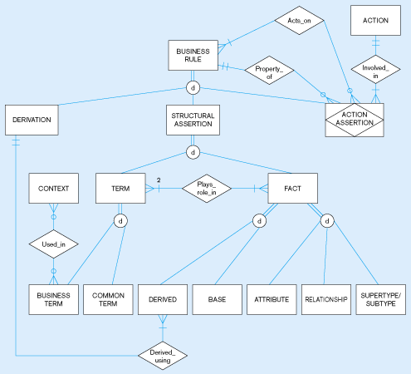
Figure 15 EER depiction of business rules classification

Slide 28
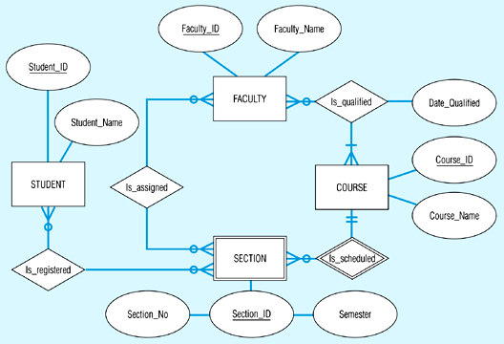
Data model segment for class scheduling

Slide 29
Sample Entity Definitions (Figure 13)
FACULTY
  A university employee who is academically qualified to teach courses and perform other designated duties
COURSE
  A module of instruction in a particular subject area
SECTION
  An offering of a course during a particular semester
STUDENT
  A person who has been admitted to the school and who has registered for at least one course during the past year

Slide 30
Sample Relationship Definition (Figure 15)
Is_Qualified (M:N)
  Description: associates each faculty member with the course(s) he or she is qualified to teach based on academic preparation and experience
  Constraint: each faculty must be qualified to teach at least one course
Is-Scheduled (M:N)
  Description: associates each course with the sections that have been scheduled for that course
Is_Registered (M:N)
  Description: associated each student with the course sections for which he or she is registered during the current semester
Is_Assigned (M:N)
  Description: associates each faculty member with the course section(s) he or she is assigned to teach during the current semester

Slide 31
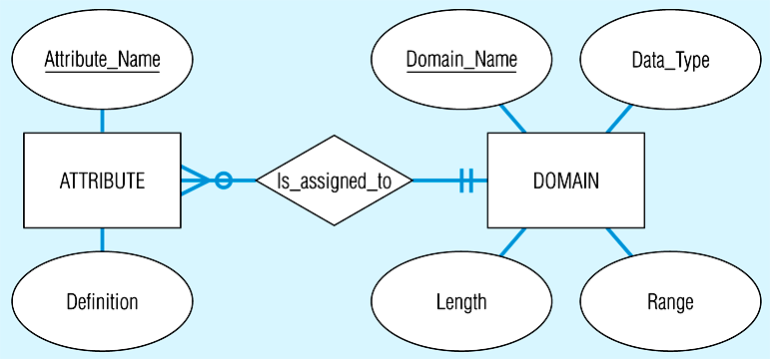
Relationship between attributes and domains

Slide 32
Sample Domain Constraints (Figure 16)
Person_Ids
  Type: Character
Person_Names
  Type: character
  Max. Length: 30
Course_Ids
  Type: character
  Format: ssssnnnn where ssss=subject and nnnn=course number
Course_Names
  Type: character
  Max length: 30
Sectoin_Nos
  Type: Integer
  Length: 1
Semesters
  Type: character
  Format: ppppyyyy
  where pppp=period allowable values=“Fall”, “Sprg”, “Summ”
  yyyy=year
Dates
  Type: date

Slide 33
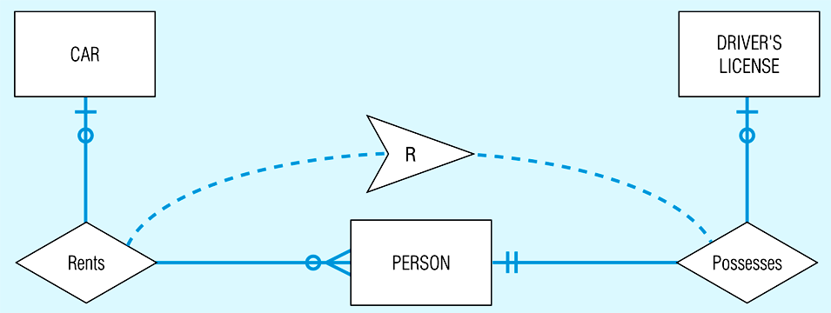
Adding Symbol to Enforce Business Rule:
A person can rent a car only if he or she possesses a valid driver’s license

Slide 34
Stating an Action Assertion
Anchor Object – an object on which actions are limited
Action – creation, deletion, update, or read
Corresponding Objects – an object influencing the ability to perform an action on another business rule
Example
  “A person can rent a car only if he or she possesses a valid driver’s license.”
Action assertion will identify corresponding objects that constrain the ability to perform actions on anchor objects

Slide 35
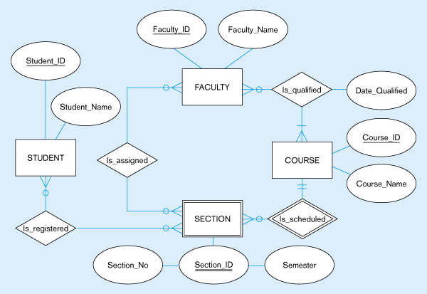
Figure 16 – Data model segment for class scheduling

Slide 36
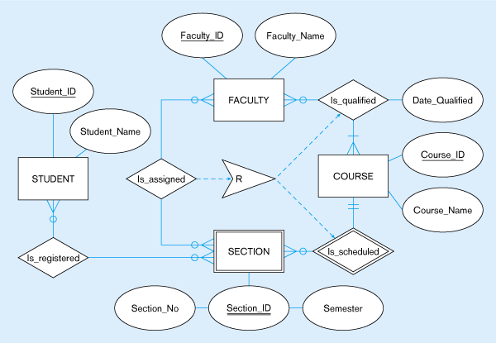
Figure 17 – Business Rule 1: For a faculty member to be assigned to teach a section of a course, the faculty member must be qualified to teach the course for which that section is scheduled
Corresponding object
In this case, the action assertion is a Restriction
Action assertion
Anchor object
Corresponding object

Slide 37
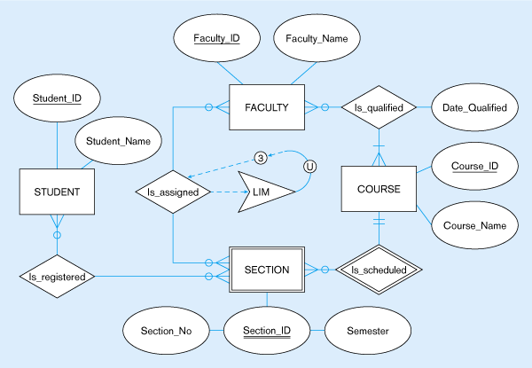
Figure 18 –Business Rule 2: For a faculty member to be assigned to teach a section of a course, the faculty member must not be assigned to teach a total of more than three course sections
In this case, the action assertion is an
Upper LIMit
Corresponding object
Anchor object
Action assertion

Slide 38
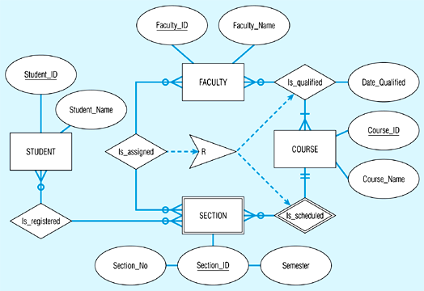
Business Rule 1: For a faculty member to be assigned to teach a section of a course, the faculty member must be qualified to teach the course for which that section is scheduled.

Slide 39
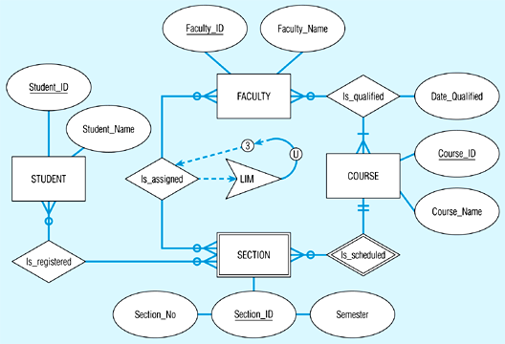
Business Rule 2: For a faculty member to be assigned to teach a section of a course, the faculty member must not be assigned to teach a total of more than three course sections.

Slide 40
Action Assertion Classifications
Result
  Condition – IF/THEN rule
  Integrity constraint – must always be true
  Authorization – privilege statement
Form
  Enabler – leads to creation of new object
  Timer – allows or disallows an action
  Executive – executes one or more actions
Rigor
  Controlling – something must or must not happen
  Influencing – guideline for which a notification must occur

Slide 41
Constrained and Constraining Objects
Constrained Object
  An entity, attribute, or relationship on which operations (create, delete, update, read) are limited
Constraining Object
  An entity, attribute, or relationship that influences the ability to perform an operation (create, delete, update, read) on another object
Example
  “A person can rent a car only if he or she possesses a valid driver’s license.”
  Constrained: Rents; Constraining: Possesses

